Slide 1
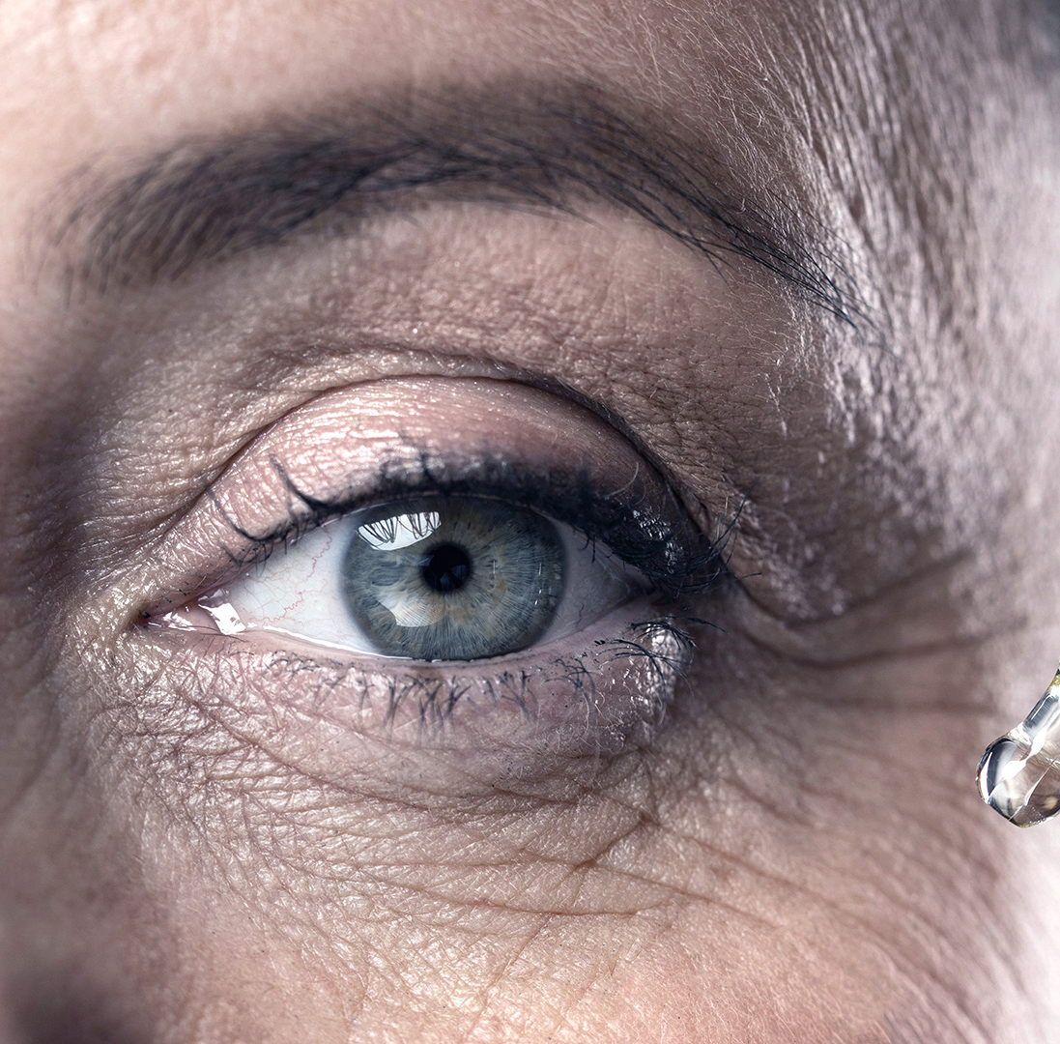
Drowsiness Detection
Aleks Lazowski,
Chris Chang,
Jacinto Lemarroy,
Shrey Sood

Slide 2
Table of Contents
01
01
02
03
04
05
06
Introduction
EDA
Models: Dense
Models: VGG
Models: MobilNet
Conclusion

Slide 3
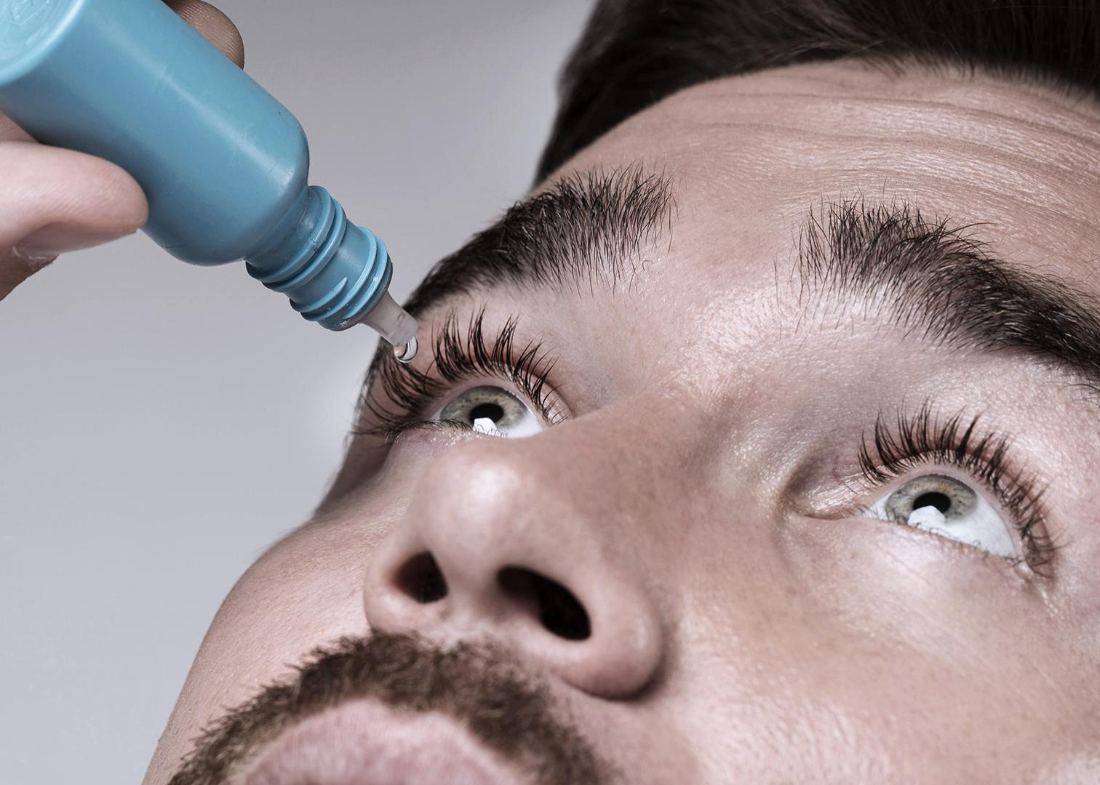
01
Introduction
Notes:
For our data, we decided to implement the MRL dataset which included images from open and closed eyes. The original dataset had over 37 folders with thousands of images in each. We decided to use a slice of the data to help with runtime and imports. Our team concluded with 4000 images which evenly split open and closed eyes in the photos. This 2000 split ensures that the model runs on an equal amount of images for both classifications.
The goal of our project is to be able to predict whether a persons image has their eyes open or closed. This model could impact drowsiness detection and be able to assist drivers who are victims of car accidents due to falling asleep on the wheel

Slide 4
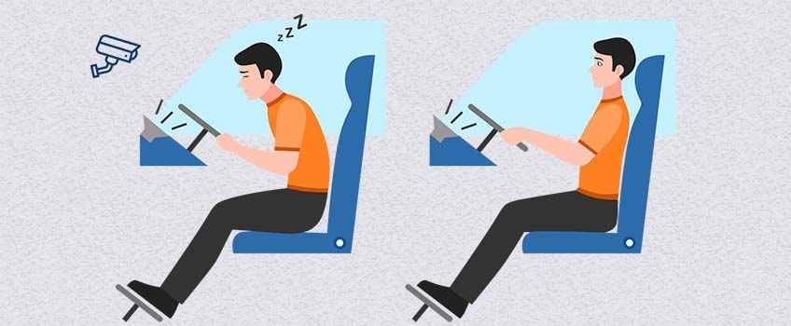
Abstract
Drowsiness is among the important factors that cause traffic accidents; therefore, a monitoring system is necessary to detect the state of a driver’s drowsiness. In the case of autonomous driving levels 4 and 5, where the driver is not the primary driving agent, this model is particularly very helpful in order to avoid road mishaps due to driver negligence and ignorance.

Slide 5
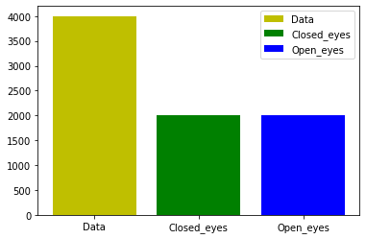
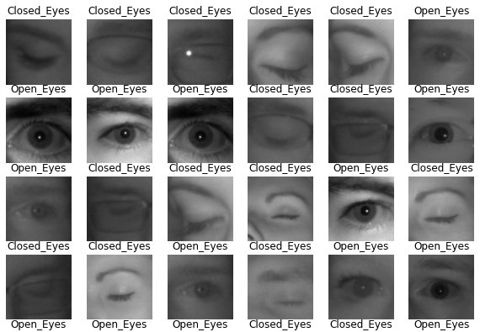
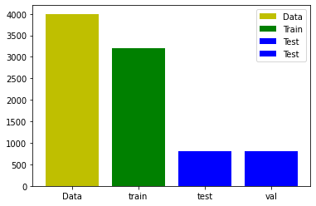
EDA
Notes:
Here we delve into what our data looks like. We look at examples of the images as well as the class types. We visually represent the distribution of the classes as well as the data split into train, test and validation. As you can appreciate, our data is evenly distributed between the two classes (open and closed eyes) and amongst the data splits.

Slide 6
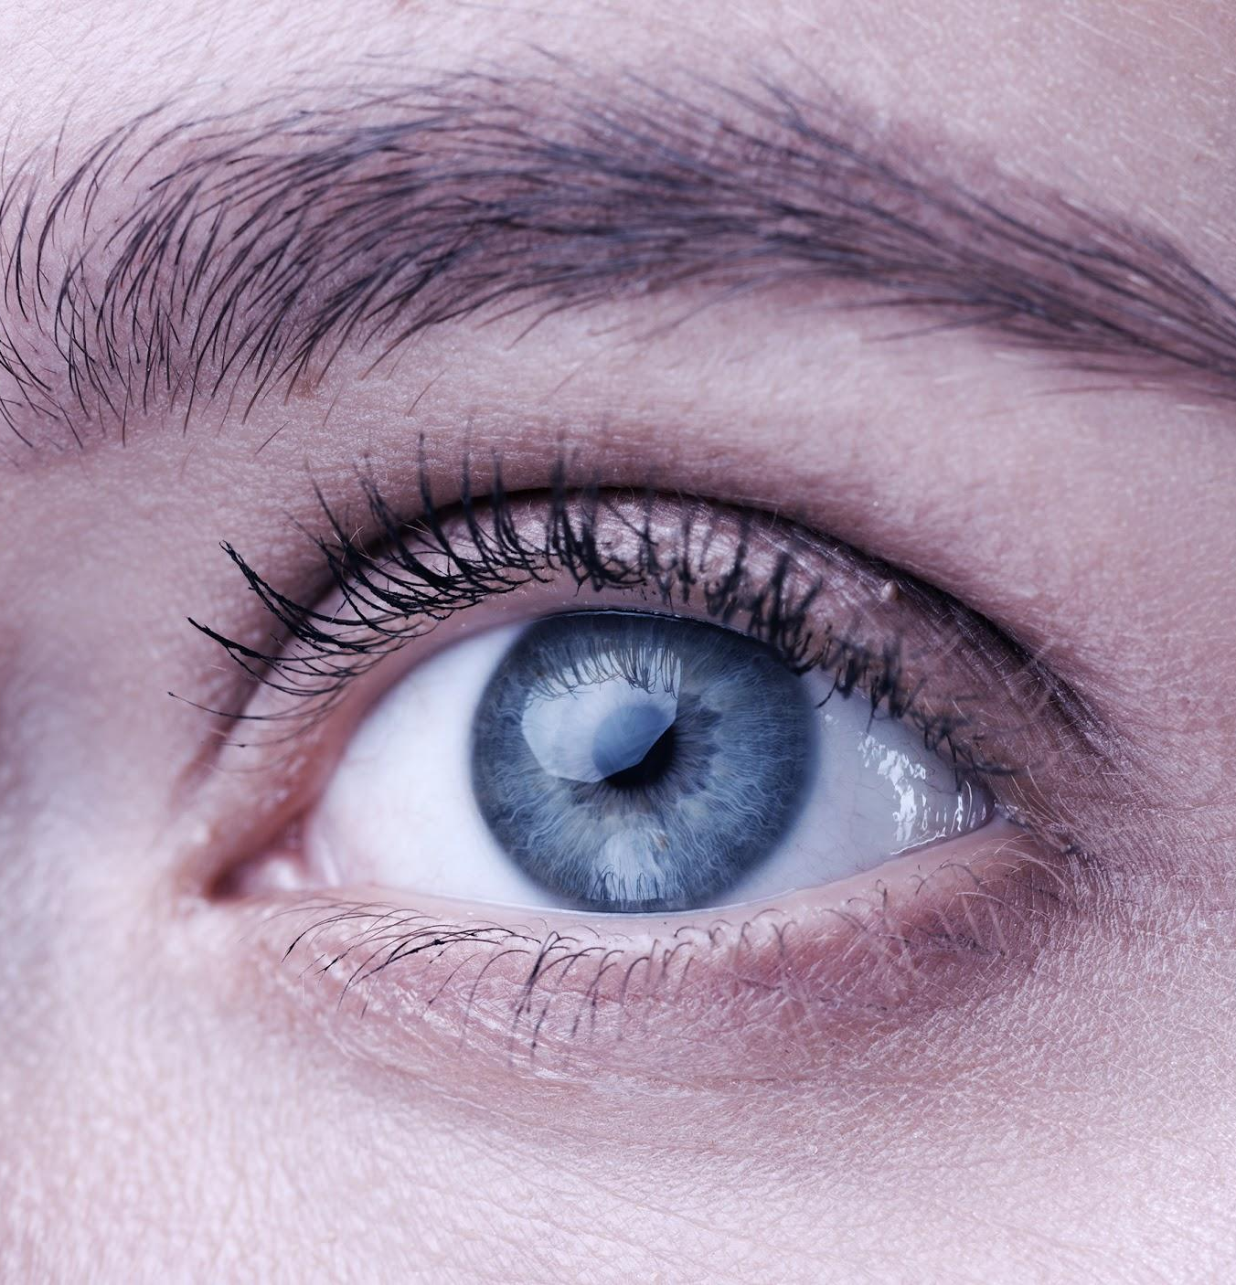
02
Models

Slide 7
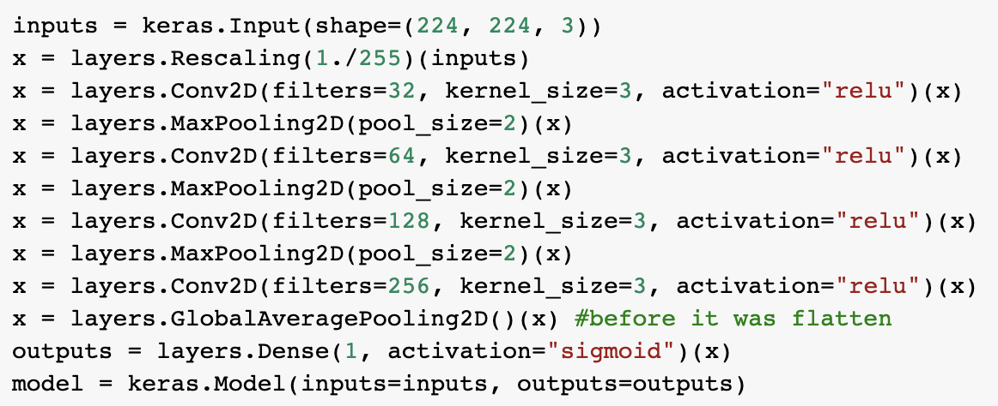
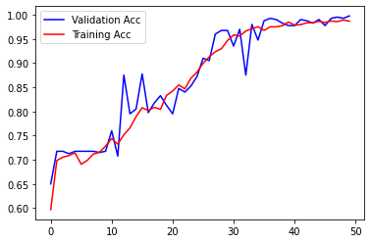
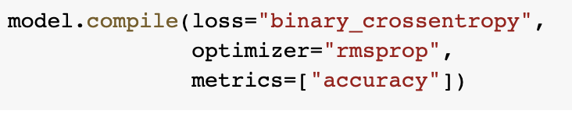
Dense Model
Notes:
Initially we used flatten as the last layer but after tweaking around we found that using globalavgpooling on the spatial dimensions gave us a better and more consistent performance
We have a binary outcome variable, hence our use of Sigmoid activation on the output layer. We will use binary cross-entropy loss as our loss function. And, we'll monitor accuracy.
This callback we are defining will write the current best model (and parameter values) to disk, based on minimum validation loss.
When fitting the model we played around with the number of epochs and the batch size that would give us optimal performance. We increased the batch size to 100 since that gave us less noise in the gradients and so better gradient estimate based on our output accuracy. We went with 50 epochs because that allowed the model to near 100% accuracy
Our model does fairly well in reaching high accuracy of above 90% with a few drops in accuracy but continuing to increase with the epochs.
Test accuracy: 0.987500011920929

Slide 8
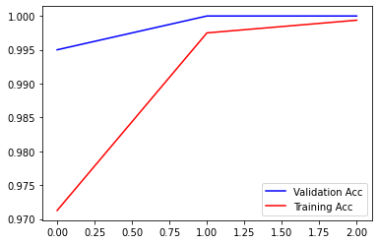
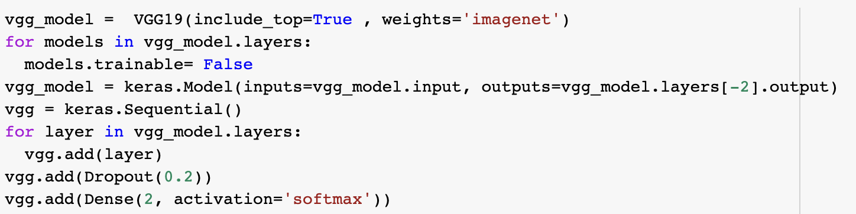
VGG Model
Notes:
Now we are going to load a pre-trained model, to leverage its convolutional base for our task. Note that the convolutional base, alone, has about 15 million parameters.
We use VGG19 specifically because it is a comprehensive model trained with 19 layers and trained on more than a million images.
In our code we defined a new model that sits at the end of the VGG convolutional layer. Pass them to a Dense layer, then feed to a one-node softmax output (with some Dropoutof 0.2). This model will fit extremely quickly, and it's accuracy will be way higher, approaching 97%

Slide 9
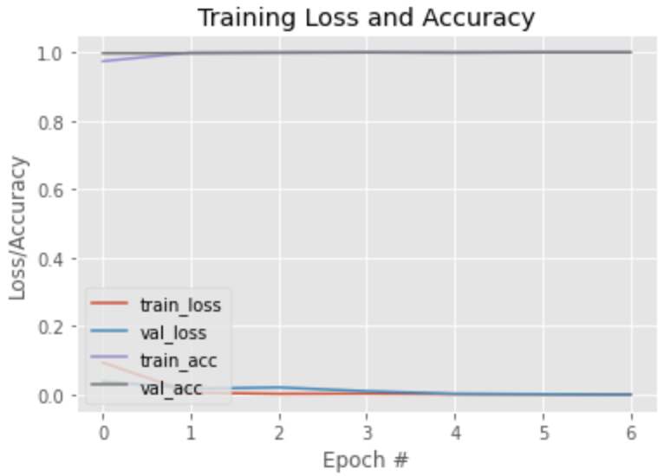
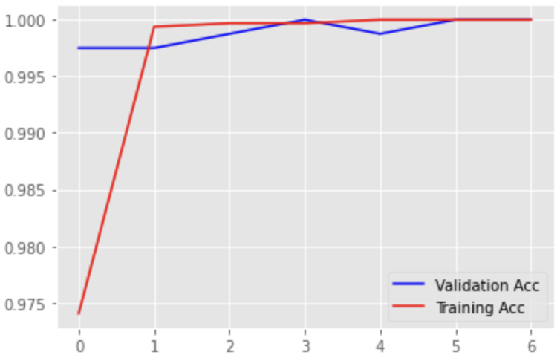
MobileNet
As a lightweight deep neural network, MobileNet has fewer parameters and higher classification accuracy.
In this model classification, if the value is closer to 1 it means eyes are open and if closer to 0, it means that eyes are closed

Slide 10
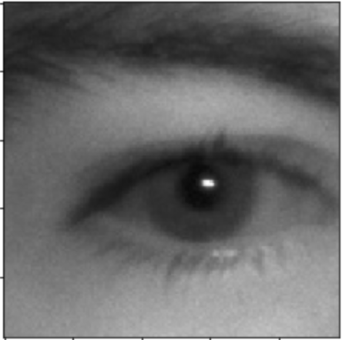
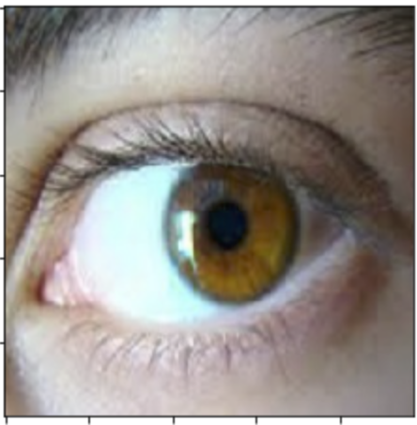
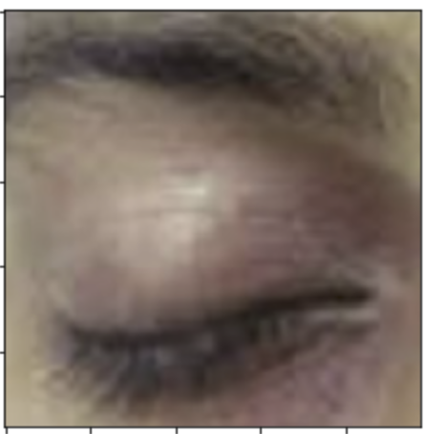
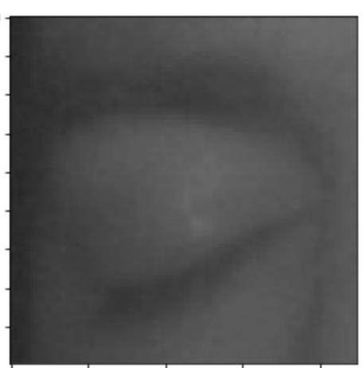
Can our Model Accurately Predict?
Variation of Images
Chosen from test data and google
Predictions were Accurate
Using Pre-trained model VGG with ImageNet
Notes:
VGG was used because it is a popular pre-trained model for image classification. In this code we included imagent as a weight .
The goal of this image classification challenge is to train a model that can correctly classify an input image into 1,000 separate object categories. ImageNet challenge is the de facto benchmark for computer vision classification algorithms

Slide 11
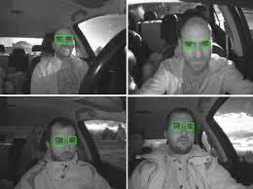
Conclusion
1
2
Conclusion
3
4
All 3 models concluded with results and accuracy scores close to 1.00
Indicates the similarity in the images and dataset and how well models are able to predict
Imported images had correct classification
Question looms how often will the model be correct?
How big is the error?

Slide 12
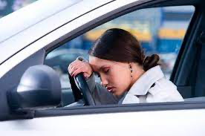
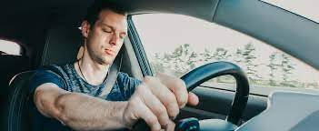
Potential Future Steps
With Success predicting images of open & closed eyes
Further research for video prediction and classification
To improve performance, include different images. Sunglasses, side of head, different backgrounds
Create AI machine to play sounds if a human is falling asleep on the road

Slide 13
Thank You

